Slide 1

How AI Hardware Can Lower the Cost of Healthcare
Dan McCreary – Distinguished Engineer
AI Hardware Summit, Sept 14th, 2022

Slide 2
Talk Description
One of the biggest challenges in the US is managing the cost of healthcare. Although we have high healthcare costs in the US, our life expectancy is still average. In this talk we will look at some of the core causes of healthcare costs and what modern AI hardware can do to lower these costs. We will see that faster and bigger GPUs alone will not save us. We need detailed models to across a wide swath of our communities and perform early interventions. We need accurate models of our world and the ability to simulate the impact of policy changes to overall healthcare costs. We need many cores and memory architecture that keep cores fed with the right data.

Slide 3

Average Life Expectancy?
Average life expectancy at birth in the US in 2021:
76.60 years
Note: 2019: 78.86 (a net loss of 2.26 years)
Compare: Costa Rica in 2021: 80.56 years
Source: World Development Indicators: https://databank.worldbank.org

Slide 4

Average Cost of Healthcare Per Person
Per capita cost of healthcare expenditures in the US for 2020: $12,530
U.S. health care spending grew 9.7% in 2020
Percent of US GDP: 19.7%
Compare: Costa Rica 2019: $922/person/year
Source: US Centers for Medicare & Medicaid Services https://www.cms.gov/Research-Statistics-Data-and-Systems/Statistics-Trends-and-Reports/NationalHealthExpendData
See also: Global Healthcare Expenditure Database: https://apps.who.int/nha/database
Notes:
https://www.cms.gov/Research-Statistics-Data-and-Systems/Statistics-Trends-and-Reports/NationalHealthExpendData/NationalHealthAccountsHistorical

Slide 5

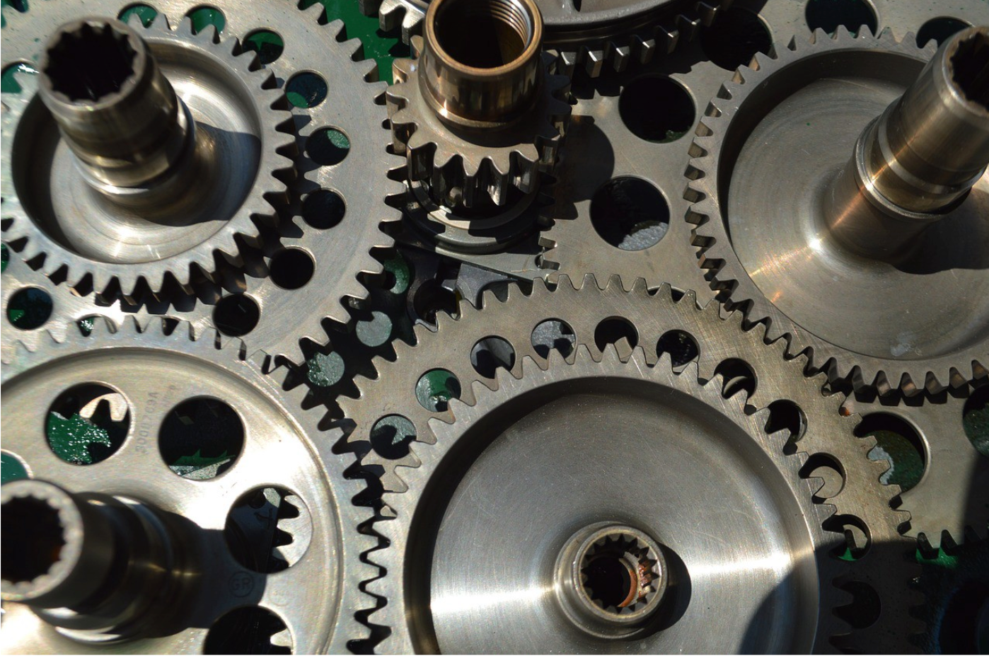
20% of GDP is Like Sand in the Gears of Our Economy
19.7% of GDP for Healthcare
Fraud, Waste and Abuse in Healthcare
Approximately 25% of total health care spending is consider waste
https://pubmed.ncbi.nlm.nih.gov/31589283/

Slide 6
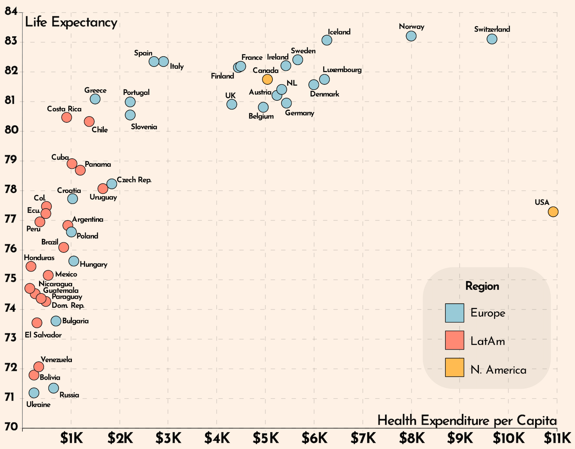
How Does This Compare To Other Countries?
Life Expectancy
Better
Worse
Health Expenditures per Capita

Slide 7

How Does This Compare To Other Countries
Source; Latinometrics visualization using 2020 World Data Bank
Notes:
https://www.reddit.com/r/dataisbeautiful/comments/w5a653/oc_does_healthcare_spending_correlate_with_life/
https://i.redd.it/yxw248cyb4d91.png

Slide 8


Why The Difference?
US
Costa Rica
19.7% of GDP
7.2% of GDP
Diet and Exercise?
Pollution?
Stress – trying to figure out how to pay health insurance premiums?
Lifestyle?
Political corruption?
Income inequality?

Slide 9
Ways to Increase Life Expectancy
Smoking – 480,000 deaths annually (including deaths from secondhand smoke) - smoking prevention and cessation
Obesity – 300,000 deaths annually– exercise and weight loss programs
Opioid overdoses – 91,799 deaths annually in 2020 - screening for mental health
Suicides – 45,979 deaths annually in 2020 - mental health awareness
Firearms - 45,222 gun-related deaths annually in the US 2020
Road accidents – 42,915 deaths in the US 2021 - auto safety research
Sources: CMS, CDC, US DOT

Slide 10
Ways to Lower Costs
Use data science to predict if a procedure is cost effective

Slide 11

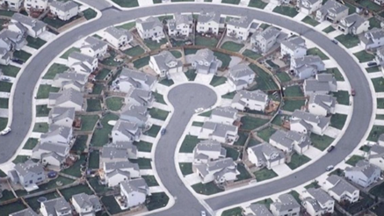
The Machine Learning Cul-de-sac
Strong AI
Not possible?!
Little Models of the World
(LMW)
Causal Models!
ML Alone
Neural-Symbolic AI
Today
Can machine learning alone get us to artificial general intelligence?
Rodney Brooks: ML has become a cul-de-sac for strong AI

Slide 12


Why Generalization?
In order to build a general intelligence, you need to optimize for generality itself.
Intelligence i.e., generalization power is...sensitivity to abstract analogies...and in fact, that is all there is to it.
Francois Chollet
Intelligence and Generalization from Machine Learning Street Talk https://youtu.be/J0p_thJJnoo?t=70

Slide 13
Generalization and Rules
Many Low-Level Rules
Generalization
Cars have wheels
Trucks have wheels
Motorcycles have wheels
There are many types of vehicles
Vehicles have wheels
Vehicle
HAS_RULE
Rule
Vehicle Ontology:
“Has Wheels”
IS_A
IS_A
IS_A
Car
Truck
Bicycle

Slide 14
Example: Patient Chart and Drug Taxonomy
A provider types in “abi” into a patient’s chart search and all the antibiotic prescriptions are listed
Antibiotics
HAS_LABEL
Label
“abi”
IS_A
IS_A
TYPE=alternate_label, abbreviation
IS_A
Penicillin
Antifungal
Tetracycline

Slide 15
Neuro-symbolic AI
Systems that integrates neural network-based learning with symbolic knowledge representation and logical reasoning with the goal of creating an AI system that is both interpretable and trustworthy
How can we use Neuro-symbolic AI in real-time clinical decision support (CDS) at the point of care?
Machine
Learning
Neuro
Symbolic AI
Symbolic
AI

Slide 16
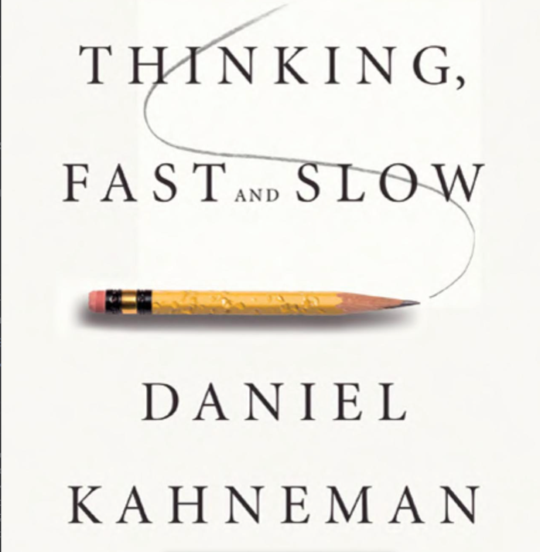
Thinking, Fast and Slow
Humans’ decisions are guided by two main kinds of capabilities, or “systems”: system 1, and system 2.
System 1 provides us tools for intuitive, fast, and unconscious decisions, which could be viewed as “thinking fast”.
System 2 handles complex situations where we need rational thinking and logic to make a decision. We call this “thinking slow”.
Notes:
Thinking Fast and Slow in AI
Dec 2020
https://arxiv.org/abs/2010.06002
Consider an AI system that is based on the two main sets of capabilities provided by ML and symbolic AI. Usually the quality of ML approaches is measured by the degree to which they can achieve the desired result, e.g., accuracy, precision, recall, F1 score. On the other hand, the quality of a symbolic reasoning process is usually measured by the correctness of its conclusions, e.g., the satisfaction of a set of constraints. In a combined system1/system2 AI system which switches dynamically between the two opportunis- tically, or combines their capabilities, selecting evaluation measures and methods is an open research question

Slide 17

The One Second Rule
If a typical person can do a mental task with less than one second of thought, we can probably automate it using AI either now or in the near future.
Andrew Ng

Slide 18
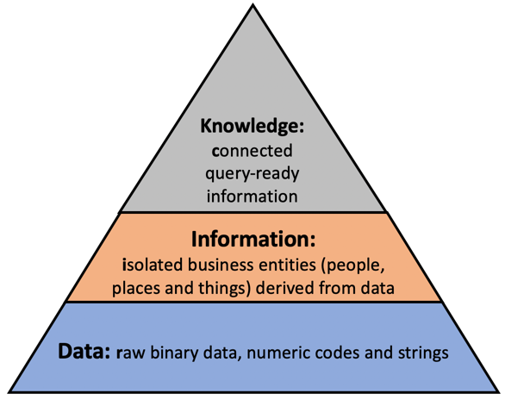
Data vs. Knowledge
Fast System 1: driven by data
Slow System 2: driven by connected data: knowledge
https://dmccreary.medium.com/the-knowledge-triangle-c5124637d54c

Slide 19

Human Brain: Thinking, Fast and Slow
Fast Thinking (System 1) | Slow Thinking (System 2)
Unconscious and automatic | Thoughtful and effortful
Pattern recognition | Logic and reasoning
Best with images, sound, language | Planning and cognition
Parallel | Serial
Can’t count | Counting is core
Event correlation | Event causation
> 95% of brain energy | < 5% of brain energy
Well understood | Poorly understood

Slide 20
Computers: Patterns vs Symbolic Reasoning
Machine Learning Patterns | Symbolic Reasoning
Done by neural networks | Done by rules and knowledge graph traversal
Measure success based on precision, recall and F1 score | Measure success based on correctness of conclusion
Low Explainability | High explainability
Pattern recognition and similarity | Logic and reasoning
Best with images, sound, language | Planning and cognition
Event correlation | Event causation?
Well understood | Poorly understood
Focus of machine learning | Focus of taxonomies, ontologies and graph algorithms

Slide 21

The Representation Problem
The key to artificial intelligence has always been the representation.
Jeff Hawkins
Thousand Brains and the Enterprise Knowledge Graph
https://towardsdatascience.com/1000-brains-and-the-ekg-8ef7b1764ccd
Machine Learning Street Talk https://www.youtube.com/watch?v=6VQILbDqaI4

Slide 22
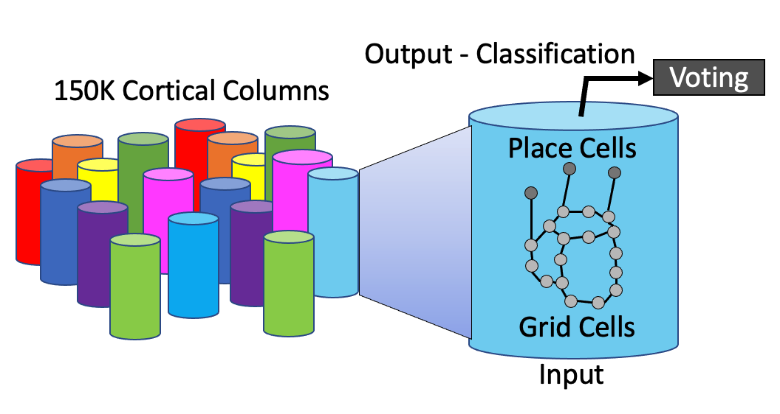
Reference Frames (Hawkins)
The human neocortex is composed of around 150K cortical columns
Each column predicts output from inputs
The fundamental unit of communication is a “reference frame” built from grid and place cells
Reference frames are idealized models of things around us
Reference frames help us classify, find similar items and detect anomolies
Reference frames can connect a pattern with a symbolic label

Slide 23
Symbolic Standards
Right Symbolic Path
Rules
Symbols
Codes
Wrong Path!
Standardized definitions
Standardization representations
Results
Avoid duplication of effort
Avoid missing patients that should be included
Avoid including patients
Avoid technical debt
We can solve any problem by introducing an extra level of indirection.
- David Wheeler

Slide 24
Take Home Points
Every time we create rules that reference low-level codes, we are creating new technical debt
Symbolic AI avoids technical debt because the relationships that bind symbols and codes are centralized

Slide 25
Graph Embeddings
Embedding
Patient
Allergies
Embedding quick allow us to find similar items
Similar concepts, similar conditions, similar codes
We can use machine learning to build embeddings for any vertex in the healthcare graph
Can we use embeddings to refine healthcare concepts
Conditions
Vaccinations
Symptoms
Diagnosis
Demographics
Medications

Slide 26
Heathcare Concept
A graph VertexType that binds a symbolic concept to the coding systems related to that concept
Designed to be promote reuse and composability
Can be combined using Boolean logic (AND/OR/NOT)
IDENTIFIED_BY
Diagnosis
Code
HAS_SUBGROUP
Healthcare Concept
Procedure
Code
Name (label)
Description
Drug
Code

Slide 27
Summary
We need your help!
Helps us find machine learning to find patterns in clinical data
Help us build embeddings for patients and concepts
Leverage symbolic rules
Symbolic reasoning and Healthcare Concepts help us implement reusable, explainable and scalable rules and avoid technical debt
Help us bring the best of both worlds together!

Slide 28
References
Thinking Fast & Slow — A Machine Learning Practitioner’s Perspective, Sept. 2018 https://towardsdatascience.com/thinking-fast-slow-a-machine-learning-practitioners-perspective-6f4bdba2cb44
Third Wave of AI | Thinking Fast and Slow
https://www.louisbouchard.ai/third-wave-of-ai-thinking-fast-and-slow/

Slide 29
Dan.McCreary@optum.com Mark.Megerian@optum.com

